Slide 1


Navy Enlisted Advancement System
Navy Advancement Center
Unclassified

Slide 2
Presentation Topics
Mission of the Navy Advancement Center (NAC)
Advancement Exam Development
Preparing for Advancement Exam
Bibliographies on NKO/MNP, Navy COOL Site and App
Advancement Exam Eligibility
Your Exam Profile Sheet
Your Final Multiple Score/App (FMS)
Publication of Results
Navy Advancement Center
Unclassified

Slide 3
Mission Statement
Support the Navy's enlisted advancement system by developing and publishing in-rate examinations based on occupational and professional knowledge requirements, and processing exam answer sheets and records to rank-order the most qualified candidates for advancement.

Slide 4
Advancement Exam Development
Written by rating CPO’s (E-7 to E-9) – NAC hosts panels for each rating on an “as needed” basis.
Attendance requirements will vary based on the needs of each rating:
Recent Fleet Experience
From ratings (ETN, HM, etc.) or
From rating communities (Aviation, Information Warfare, etc.)
The latest schedule and application procedure can be found on the NAC NKO portal.
Unclassified

Slide 5
Advancement Exam Development
Process for Test Plan / Item Development:
Test Plan Development – Completed and revised as needed based on rating requirements to ensure Job Taxonomy (job description) is current.
Bank Transition – Map existing bank to current Test Plan and again if Job Taxonomy changes.
Item Development – Completed as needed to ensure validity of item banks and to create new questions based on the Test Plan.
Bank Item Review – Confirm question/answer for currency, correctness, relevancy, and importance, review poor performing questions and update references.
Unclassified

Slide 6
Advancement Exam Development
September 2012 exams went to 175 questions
Advancement exams are designed to test task based rating knowledge and to a limited extent of professional military knowledge (PMK)
PAYGRADE | OCCUPATIONAL |  | PMK
E-7 | 100 | 150 | 100 | 25
E-6 | 115 | 150 | 85 | 25
E-5 | 135 | 150 | 65 | 25
E-4 | 150 | 150 | 50 | 25
Unclassified

Slide 7
Preparing for Advancement Exam
START EARLY – Don’t wait until the last minute
Make sure all eligibility requirements are met
Make sure you understand “sustained superior performance” on evaluations
Ensure you know about the tools to help you succeed:
Bibliography – download listing and reference material
Rating topics / sub-topics
Schools
Profile sheets
Verify all information is current and accurate on worksheet and answer sheet
Unclassified

Slide 8
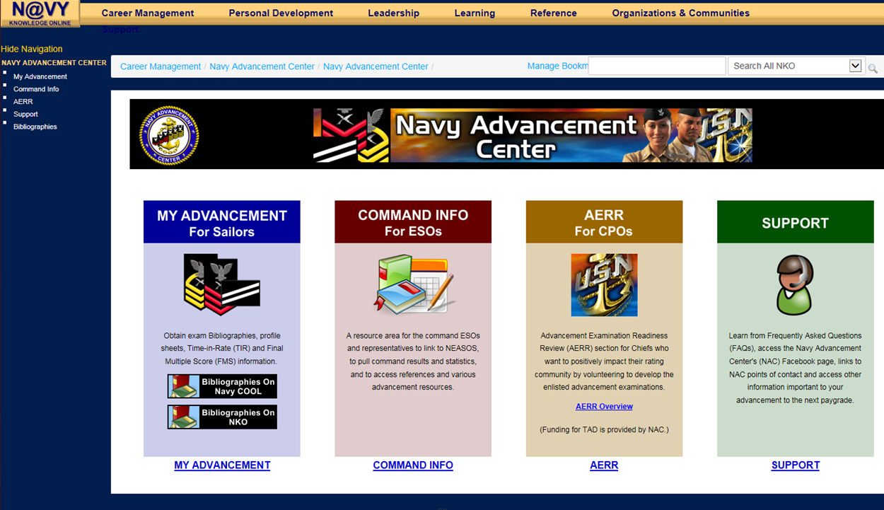
Preparing for Advancement Exam
Navy Knowledge Online (NKO)
Unclassified
Notes:
REMOVE (LEE CARVER) NAME FROM NKO Page on Slide 9 and 10

Slide 9
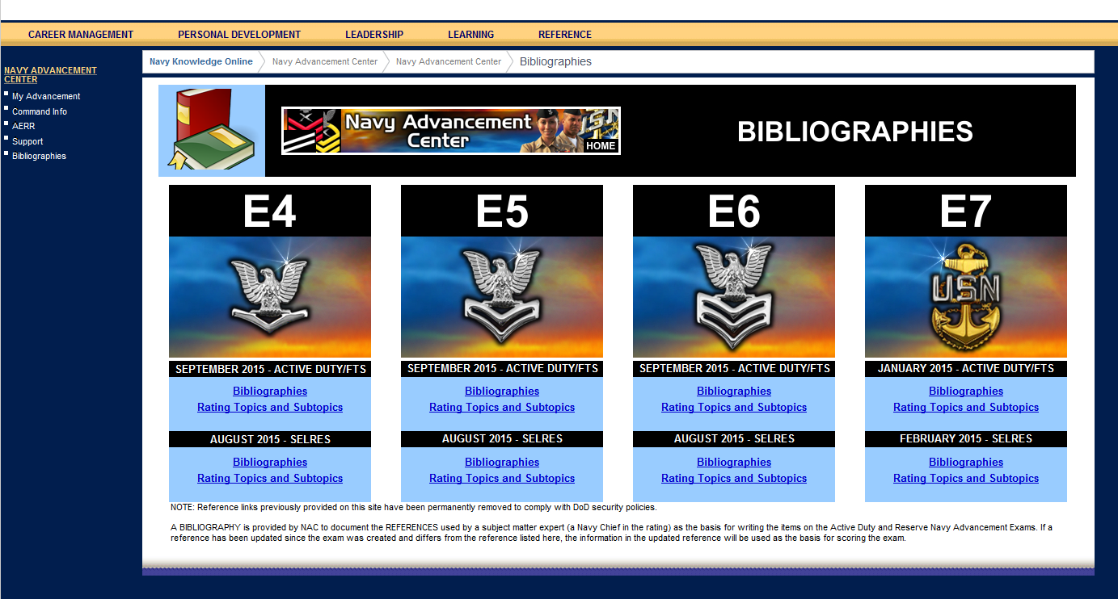
Preparing for Advancement Exam
NKO Navy Advancement Center
Unclassified
Notes:
Remove (Lee Carver)

Slide 10
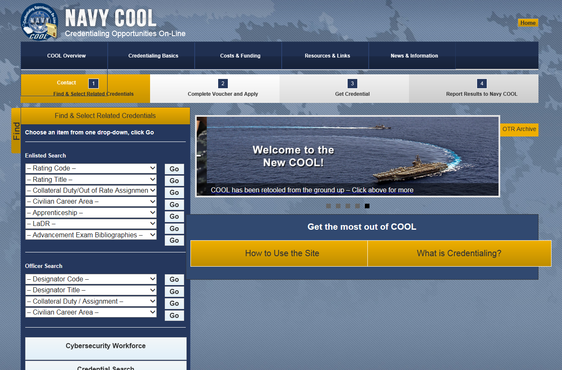
Preparing for Advancement Exam
Navy COOL Site
Unclassified
Notes:
Remove (Lee Carver)

Slide 11
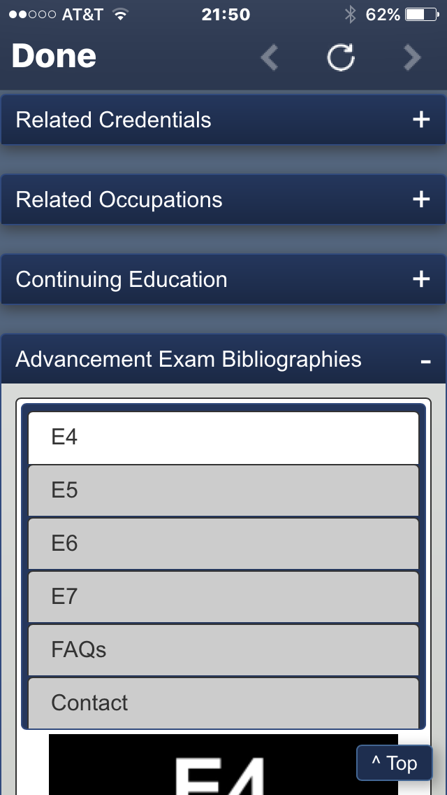
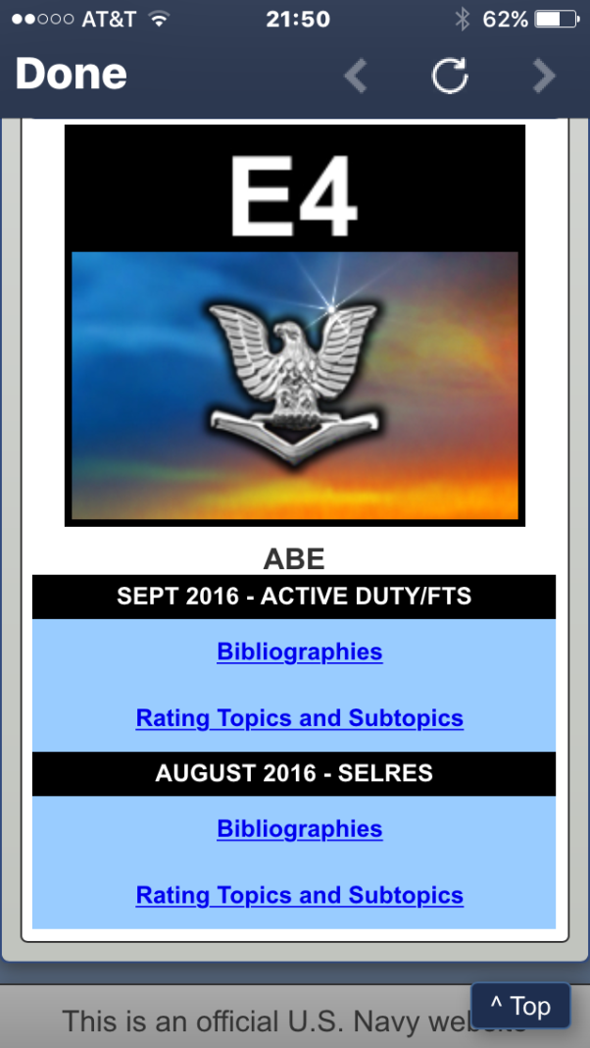
Preparing for Advancement Exam
Navy COOL App
Unclassified
Notes:
Remove (Lee Carver)

Slide 12
Advancement Exam Eligibility
Exam Schedule
EXAM | MONTH | DAY
E-7 | January | 3rd Thursday
E-4/5/6/7 | February | (Reserves)
E-6 | March | 1st Thursday
E-5 |  | 2nd Thursday
E-4 |  | 3rd Thursday
E-4/5/6 | August | (Reserves)
E-6 | September | 1st Thursday
E-5 |  | 2nd Thursday
E-4 |  | 3rd Thursday
Unclassified

Slide 13
Advancement Exam Eligibility
Requirements:
Be recommended by CO / OIC
Have minimum time-in-rate (TIR)
1-year TIR Waivers for E-6 / 7 EP Candidates can be granted
PAYGRADE | TIME-IN-RATE (TIR)
E-1 to E-2 | 9 Months
E-2 to E-3 | 9 Months
E-3 to E-4 | 6 Months
E-4 to E-5 | 12 Months
E-5 to E-6 | 36 Months *
E-6 to E-7 | 36 Months *
E-7 to E-8 | 36 Months
E-8 to E-9 | 36 Months
Unclassified
Notes:
See BUPERSINST 1430.16 for explanations of eligibility requirements

Slide 14
Advancement Exam Eligibility
Requirements:
Navy Advancement Manual BUPERSINST 1430.16 (series)
Be recommended by CO / OIC (Most important)
Have minimum time-in-rate (TIR)
Be in proper path of advancement
Meet special requirements (citizenship, security, medical, ASVAB) for certain ratings
Successfully complete Service School; if required
Evaluation completed within computation period for advancement cycle
Not be selected for LDO or CWO
Unclassified
Notes:
See BUPERSINST 1430.16 for explanations of eligibility requirements

Slide 15
Advancement Exam Eligibility
Requirements:
Eligibility documented in electronic service record entry
Complete Selectee Leadership Course
Enlisted Warfare Qualifications
Navy Reservists: Satisfactory drill participation
Examination participation for LDO purposes
Medical or Disciplinary Status
Pass Advancement-in-rate Examination!
Physical Fitness per OPNAVINST 6110.1 (series)
Career Waypoint-PACT (C-WAY) Approval
Not have pending requests for “voluntary” (not HYT mandated) transfer to Fleet Reserve
Unclassified

Slide 16
Your Exam Profile Sheet
Norm-referenced scores represent your performance in relation to everyone else who took the same exam at the same time as you
Advancement exams use norm-referenced scoring
You cannot determine from a norm-referenced score how many questions you answered correctly (that is reflected on your profile sheet).
You can only determine whether you scored higher or lower than others who took the same exam.
A “fail” status on the advancement exam indicates that the candidate failed to score a minimum required score (E-4: 49; E-5: 55; E-6/7: 61)
Unclassified

Slide 17
Criterion-Referenced vs.
Norm-Referenced Tests
Criterion-Referenced Testing
“Qualifying Exam”
Norm-Referenced Testing
“Discriminating Exam”
QUALIFIED
70%
NOT QUALIFIED
0 70 100
0 50 100
PASS/FAIL EXAM
(70% is passing score)
Training Tests
NOT PASS/FAIL
(Standing among relation to peers)
Advancement Exams
Unclassified

Slide 18
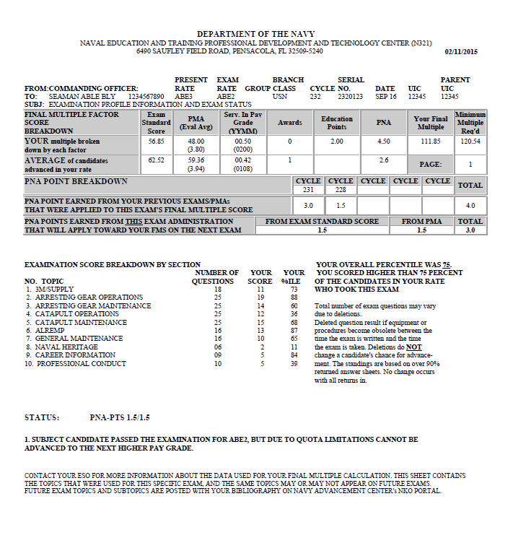
Your Exam Profile Sheet
SELECTEE
Unclassified
Notes:
Learn to understand your profile sheet and what it can tell you. Average scores, Topics, etc.

Slide 19
Your Exam Profile Sheet
Unclassified
Notes:
Your percentile information is not necessarily very helpful to the sailor. You can be in the 98% by getting only 1 question out of 10 correct. All that means is everyone else missed all 10.

Slide 20
Your Final Multiple Score
For E-7, FMS comprises a candidate's exam standard score and performance evaluations.
For E-4 through E-6, FMS comprises a candidate's exam standard score, performance evaluations, service in paygrade, awards points, education points, and previous performance based points.
E-4/5/6 candidates are advanced by quota determination based FMS rank-ordering.
E-7 candidates meeting a predetermined percent of rating population are sent to the selection board based on FMS rank-ordering
Unclassified

Slide 21
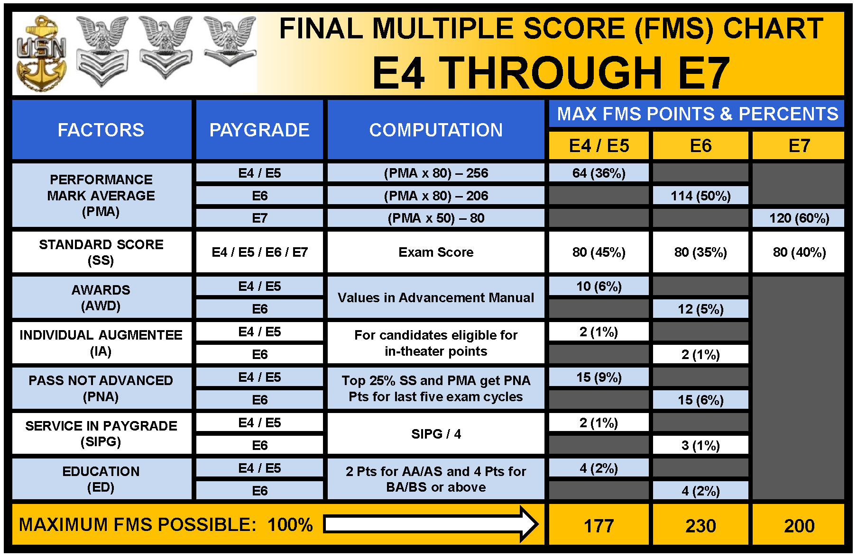
Final Multiple Score Chart E4 Through E7
FINAL MULTIPLE SCORE COMPUTATIONS EFFECTIVE AUG/SEP 2014 (CYCLES 095 AND 224)
REFER TO NAVADMINS 301/07 AND 304/07 FOR PREVIOUS FMS COMPUTATIONS
Unclassified
02/11/14

Slide 22
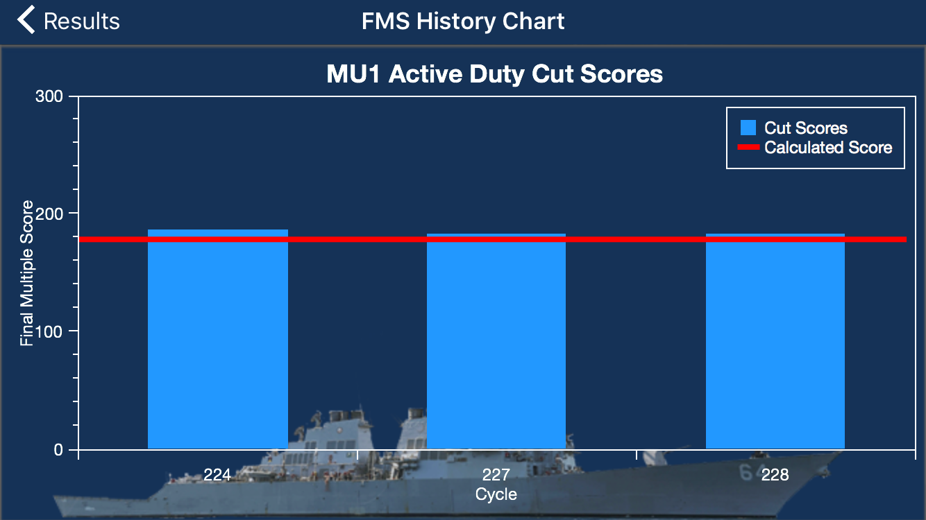
Final Multiple Score App
Unclassified

Slide 23
Your Final Multiple Score
Performance Mark Point Values
Early Promote | = 4.00
Must Promote | = 3.80
Promotable | = 3.60
Progressing (not a recommendation) | = 3.40
Significant Problems (not recommended) | = 2.00
Performance Mark Average (PMA) vs Trait Average
Unclassified
Notes:
Trait mark average has no input into your FMS. It is strictly based on your EP/MP/P standing. The trait mark average and CO’s average are only utilized by the E7 and up selection boards.

Slide 24
Your Final Multiple Score
Award | Points
Joint Service Commendation Medal | 3
Navy and Marine Corps Commendation Medal | 3
Executive Letter of Commendation | 2 (max 1)
Joint Service Achievement Medal | 2
Navy and Marine Corps Achievement Medal | 2
Combat Action Ribbon | 2
Gold Life Saving Medal | 2
Greater than 90 consecutive days of service certain designated zones / areas | 2
Letter of Commendation (Flag / Senior Executive Service) | 1 (max 2)
Unclassified
Notes:
As of August 2009 cycle, award points will increase to 12 (E-4 and E-5) and 14 points (E-6) ONLY for Sailors who have been GSA/IA BOG for 90 or more consecutive days.

Slide 25
Enlisted Advancements Made Effective by Quotas, not Your FMS
CNO/COMNAVRESFOR and the Enlisted Community Managers Determine Vacancies Based on Projected Gains and Losses
E4 / E5 / E6
Vacancies
E7 / E8 / E9
Vacancies
OPNAV
Determined Quotas
PERS Selection Board. Quotas Predetermined.
Selected for Advancement Based on FMS
Selected for Advancement Based on Selection Boards

Slide 26
Your Final Multiple Score
Pass Not Advanced (PNA) Points:
NAVADMIN 114/14
Rewarding personnel for “Sustained Superior Performance”
Awarded to those who do well on the exam or evaluations but are not advanced due to quota limitations
Points awarded each exam cycle based on combination of Performance Mark Average (PMA) and Standard Score (SS)
Up to 3.0 PNA points are awarded per exam cycle up to 5 cycles:
1.5 points max each for PMA based on ranking relative to peers:
Top 25% = 1.5 points
Unclassified
Notes:
Common mistake Sailors make is assuming they will automatically receive PNA points if they pass the exam.

Slide 27
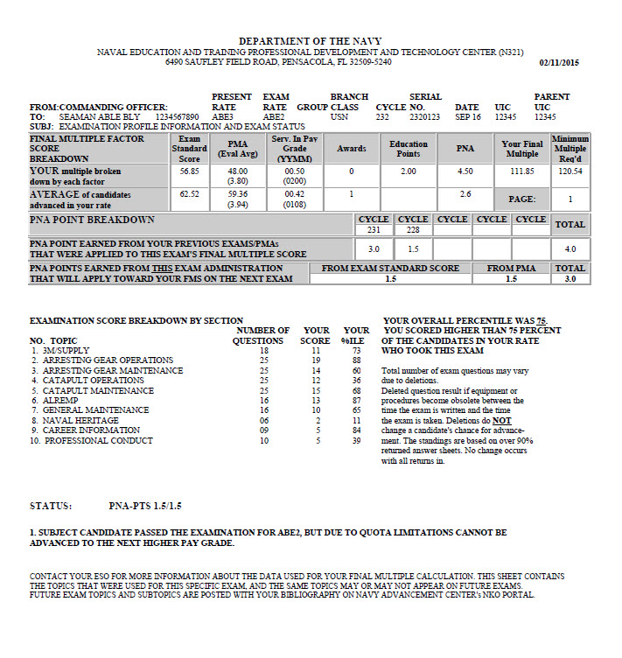
Publication of Results
Unclassified

Slide 28
Publication of Results
Advancement Status Discrepancies:
DISC means there is a discrepancy with your advancement information and your Final Multiple Score cannot be calculated until it is corrected through your ESO and the Navy Advancement Center (NAC) with supporting documentation. An unresolved discrepancy can keep an otherwise qualified sailor from being advanced.
Unclassified

Slide 29
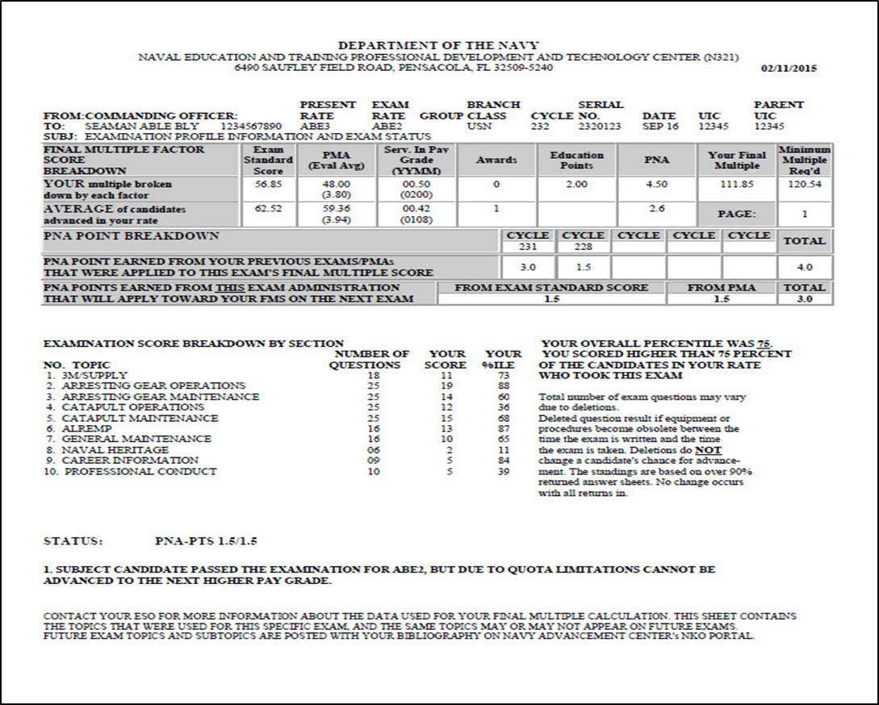
Publication of Results
0.00
DISCREPANCY
Unclassified

Slide 30
Publication of Results
Advancement Status Discrepancies:
Common Discrepancies :
Performance Mark Error – This is the #1 discrepancy.
Insufficient TIR – Your TIR does not match the requirements for the next pay grade and / or an EP Waiver was not submitted.
Wrong Path of Advancement – The rating you took did not match your current rating (BM3 took MA2 exam).
Schools Required – Your answer sheet did not indicate an ‘A’ or ‘C’ school for the ratings requiring school.
Common Corrections:
Security Clearances – this is a requisite for certain ratings and special programs
How to correct – Contact your Chain of Command and ESO
Cycle 224 had 91,700 test takers with 2,800 discrepancies
Unclassified

Slide 31
Publication of Results
Examples of Common Discrepancies:
Overwriting bar-coded information with incorrect answer sheet bubbling
Incorrect DOD ID Number
Recording exam rate incorrectly (MM vice MMN)
‘A’ or ‘C’ School not marked
Missing or incorrect PMA
SELRES not providing SIPG
Not meeting special rating requirements
Name doesn’t match
Insufficient TIR
Improper path of advancement
Unclassified

Slide 32
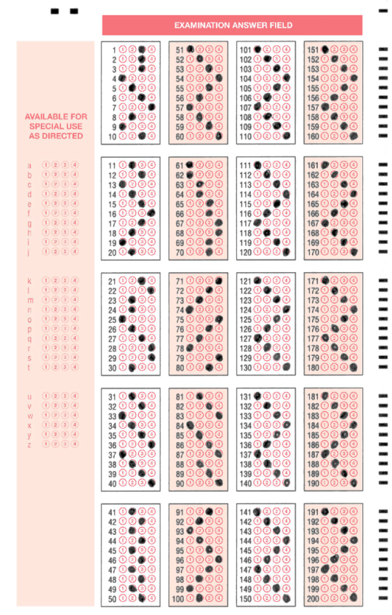
Publication of Results
Zigzag answer sheet can impact item stats
Unclassified
Notes:
This slide is used as an example for the instructor to talk about people not really trying, being forced to take the exam and/or cheating on the Navy Advancement Exam and how that adversely affects the system.

Slide 33
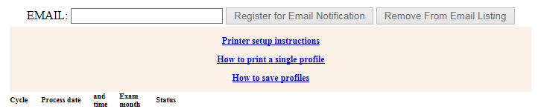
Publication of Results
Access your Profile Sheet via the Navy Advancement Center's NKO portal and register for email notifications.
This service allows you to stay informed of all profile updates and advancement status changes.
Unclassified

Slide 34
Navy Advancement Center
Navy Advancement Center on Facebook
https://www.facebook.com/pages/Navy-Advancement-Center/213190711299
Frequently Asked Questions (NAC Notes)
Advancement Results
Interactive page with same-day responses
Over 199,000 fans
Unclassified
Notes:
The NAC Facebook page is currently the 3rd most popular Navy FB page second only to the Blue Angels and The Navy

Slide 35
Navy Advancement Center
For general NEAS information or to download information:
Navy Advancement Center Home page
Facebook Fan Page
Navy Advancement Center LCPO:
MMNCS(SW/AW) Danny Chronister-
danny.chronister@navy.mil
DSN 753-6283
COMM: (850) 473-6283
Exam Questions, Errors, and Discrepancies:
Points of Contacts listed on the NAC Home Page on NKO
Unclassified
Notes:
The NAC website is listed above and some pertinent people and their numbers. This brief can be downloaded from the NAC website and you can request for a representative of NAC to provide the brief at your command (based on TAD funding availability).

Slide 36
Navy Advancement Center
QUESTIONS ?
Unclassified
Notes:
Common Misconceptions/Questions:
NAC throws out the top 10% of questions everyone gets right and the bottom 10% of questions everyone gets wrong.
There are an equal number of A, B, C, D’s on the test
Why “all of the above” is NOT a good guess
Number of letters in a row
Negative questions
When can new equipment show up on an exam?
When is old equipment removed from an exam?
Why aren’t my bibs chaptered out?
I am TAD where can I get access to my classified publications?
Why is there phased out equipment or old information on my exam?

